Slide 1
MAT 350 Engineering mathematics
Laplace and Inverse Laplace
Lecture: Handworks. Here only few problems
Lecture: 9
Dr. M. Sahadet Hossain (Mth)
Associate Professor
Department of Mathematics and Physics, NSU.

Slide 2
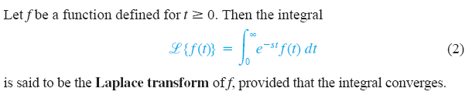
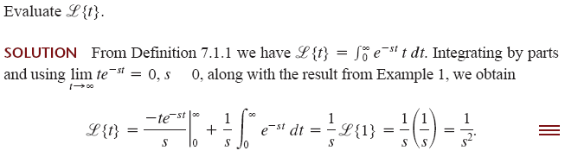

Slide 3
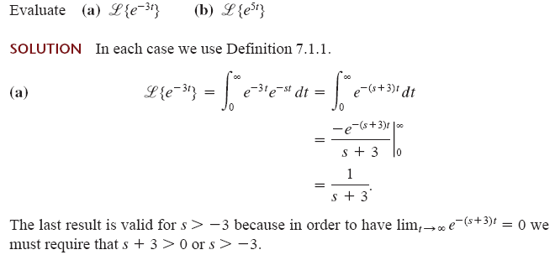

Slide 4
More
Exercises
on board

Slide 5
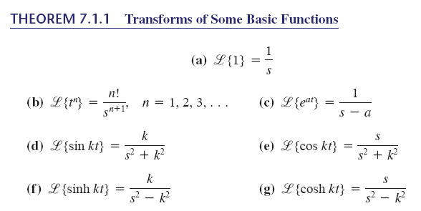

Slide 6

DEFINITION : Exponential Order
A function f is said to be of exponential order if there exist constants c, M> 0, and T> 0 such
for all t> T.
Properties of Laplace Transform :

Slide 7
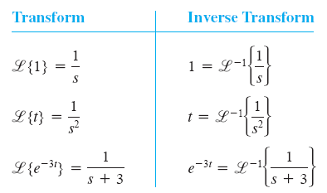
Inverse Laplace Transforms:

Slide 8
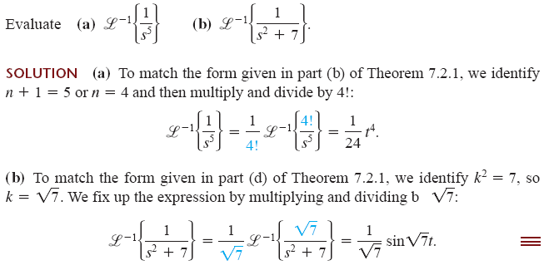

Slide 9

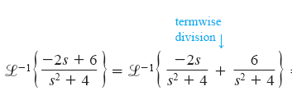



Slide 10
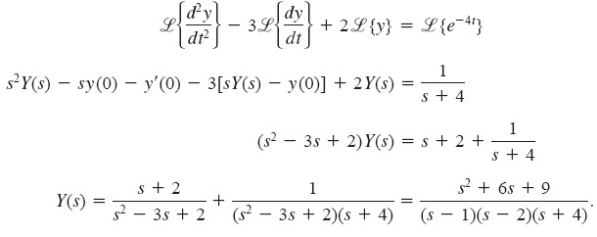
Problem:
Solution: Hints

Slide 11
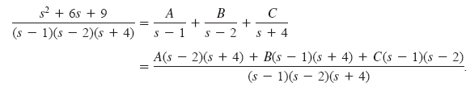




(for partial fraction, see the class lecture).

Slide 12



Exercise 7.2 (9th Edition)
Solving
The Inverse Laplace hence gives

Slide 13




Solving
The Inverse Laplace hence gives

Slide 14

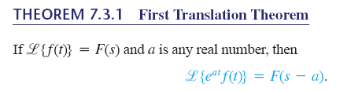
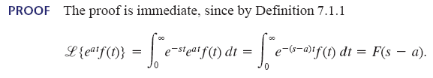


Slide 15
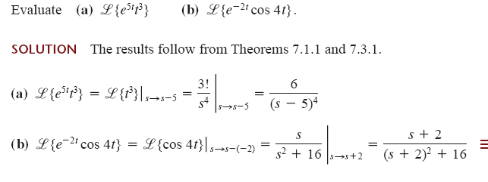

Slide 16






Sol. (a)

Slide 17
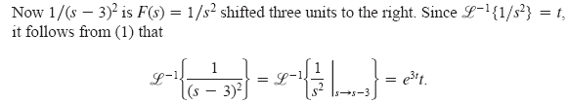

Finally,

Slide 18


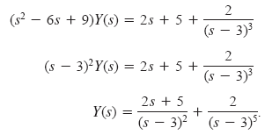

Slide 19




Using partial fraction:
We know,
Hence:

Slide 20
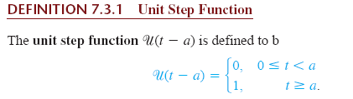
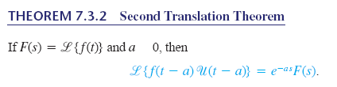

>
For inverse:

Slide 21

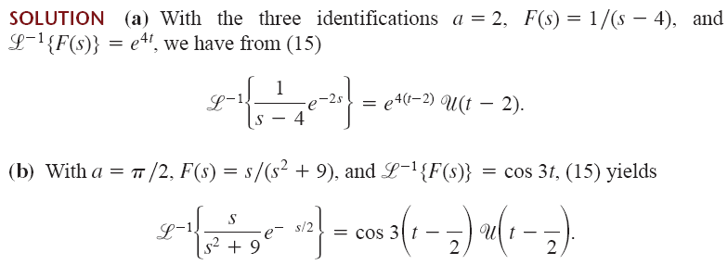

Slide 22



Exercise 7.3
Use the Laplace transform to solve the given initial-value problem
Solution:

Slide 23




Solution:
The Inverse Laplace then gives

Slide 24





Solution:
The Inverse Laplace then gives

Slide 25
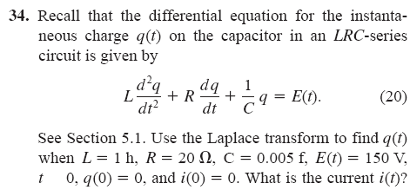



=
Solution:
Note: dq/dt = i(t),
i(0)=0 implies dq/dt at t=0 is 0 (zero).

Slide 26





+

Slide 27
Thank You.

